Slide 1
Social Media and Web Analytics
Experiments

Slide 2
Causal Research
“Cause and Effect” Relationships
Usually experiments
Highly structured designs
Emphasis on “control” groups

Slide 3
Experiments and Marketing
Aims to conduct experiments in marketing
Field experiments
Test markets
Lab experiments
Key question: “When have we identified a true causal effect?”

Slide 4
?
Ad Copy 1:
Ha-Ha!
Brand Perception
Ad Copy 2:
Wow!! - look at him…

Slide 5

Association does not Imply Causation
Young people attend rock concerts
An association between age and attendance at rock concerts
Attendance at rock concerts “causes” people to be young?

Slide 6
Spurious Correlation
Do more doctors in a region lead to a higher number of people dying from disease?
The number of doctors in a region is correlated with the number of lawyers in a region because of all of the malpractice protection needed by doctors. The higher number of lawyers in a region leads to an increase in the number of frivolous lawsuits in that region. The quantity of frivolous lawsuits drives up insurance premiums in general. The high price of insurance premiums leads to a greater percentage of the region that cant afford adequate health care. The inability for a large percentage of the region to afford adequate health care results in a large number of people dying from disease.

Slide 7
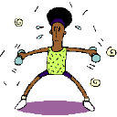

Arm Exercise and Longevity
A study found that the average life expectancy of famous orchestra conductors was 73.4 years, significantly higher than the life expectancy for males, 68.5 years. Jane Brody, in her New York Times health column reported that this was thought to be due to arm exercise.

Slide 8
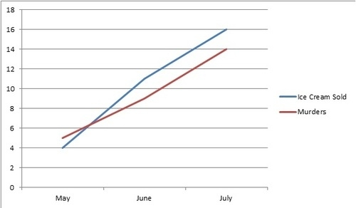
Activity – Identify the spurious correlations in the following
Ice cream consumption leads to murder

Slide 9
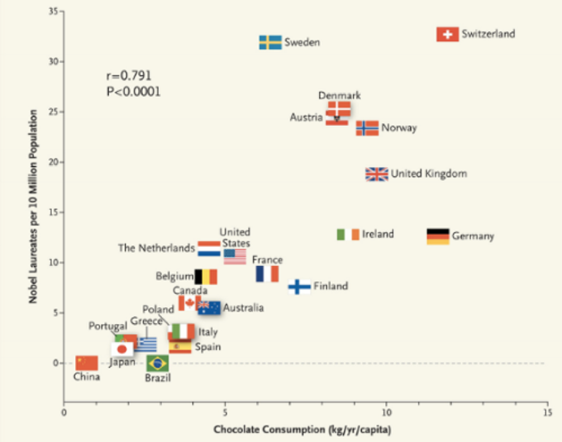
Activity – Identify the spurious correlations in the following
Chocolate consumption leads to a Nobel Prize

Slide 10

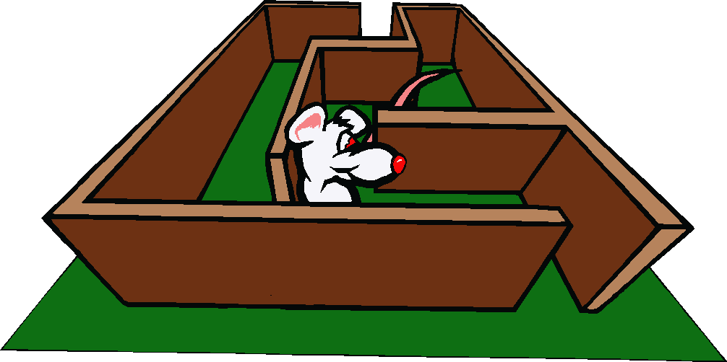
The Ideal Situation – A True Experiment
Conduct experiment to test a drug for Alzheimer's Disease prevention. Expose mice to drug and look at outcome:
Test Group
Test group
outcomes
Y₁
Stuart L.
Y₂
Y₃
Mickey M.
Speedy G.
Y₄
Y₅
Jerry
Mighty M.
Minnie M.
Y₆
Control group
outcomes

Slide 11

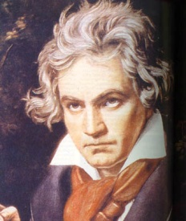

Causal Effect: Definition
The Causal Effect of some intervention is the difference in outcomes with and without the intervention
“The Mozart Effect” =
+
minus

Slide 12


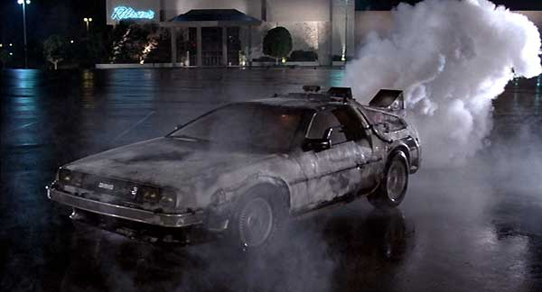

The Ideal Experiment?
How can we identify a causal effect?
Is this even possible unless we have
or
a time machine…
Superman ?

Slide 13

What is an Experiment?
Manipulate
Independent Variables
Measure Test Units
Dependent
Variables
Extraneous Variables
Control

Slide 14
Experiments in Marketing
We cannot run the “ideal” experiment
Instead we focus on experiments that are possible to execute and then make additional assumptions that – if valid – guarantees that we have uncovered a causal effect

Slide 15






Correlation vs. Causation
Classic example
Predicting Crime in a city
One good predictor is Number of Cops in the city
↑ #Cops predict ⟹↑ Crime
Does that mean increase in cops causes increase in crime?

Slide 16
Correlation vs. Causation
Probably not!
Crime may co-vary with #Cops but this may not be a causal relation
𝐶𝑜𝑝𝑠 ⟺ 𝐶𝑟𝑖𝑚𝑒
High crime areas get more Cops allocated
Therefore when crime is high, Cops is high

Slide 17
Scenarios in marketing
Decisions about marketing actions
E.g. Advertising (or Social media, Promotions etc.)
Data-based decision-making
Inspect relationship between Ads and sales (or another outcome)

Slide 18
When do you need causality?
Recommending changes
“When you do X, Y will happen ”
E.g. Sales will increase when ad spending increases
Correlation won’t work because maybe
Some factor (e.g. Diwali season)
Sales
Advertising
Sales will appear as related to Ads
But increasing Ads may not cause
an increase in sales

Slide 19
When is correlation useful?
Examples:
Android users more likely to have pets
iPhone users more likely to shop online
NDTV subscribes are more likely to be liberal
Some factor (e.g. Diwali season)
Sales
Advertising
Correlation useful in describing a situation
What is the historical trend?
Y happens when X occurs

Slide 20
How to Run Experiments?
How do we actually run experiments?
In the sciences there is a long history of lab experiments
In a lab it is relatively easy to control “external” conditions that might affect the validity of the experiment

Slide 21
The Concept of Validity
Internal Validity:
Refers to the ability of the experiment to unambiguously show a cause and effect relationship, i.e., to what extent can we attribute the effect that was observed to the experimental variable and not other factors?
External Validity:
Refers to the extent to which the results of the experiment can be generalized from the experimental environment to the environment of the decision maker; i.e., the real world
There is a trade-off between internal and external validity, from a managerial perspective.

Slide 22
Experiments in Marketing
Usually take the form of a comparison between a test and (at least one) control group
Experiments are usually run as field experiments
Customer Pool
Test Group
New Marketing
Plan
Random Sample
Random Sample
Control Group
Old Marketing
Plan

Slide 23
Example: Price Experiment
A catalog retailer selling women’s apparel
Conducted price experiment to estimate demand curves
One control group and 4 test groups
Each group consisted of 15,000 randomly sampled customers

Slide 24


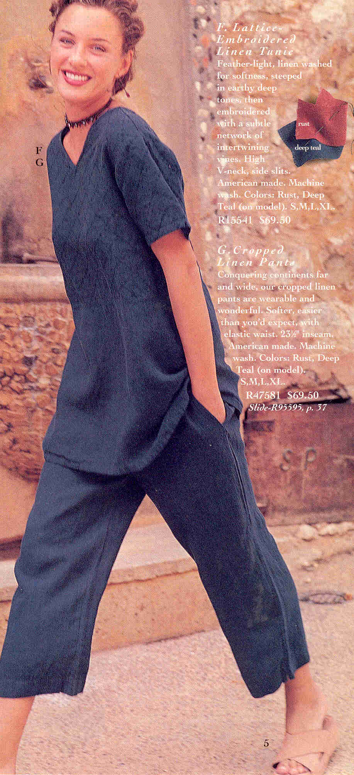


Version 1
Version 2
Version 3
Version 4
Version 5

Slide 25

Experiment 1
Objective: Trends wishes to gauge whether new more aggressive sales techniques employed by store assistants increase sales
Design:
50 stores are sampled at random and assistants are trained in the new approach
Metric =
Average Sales for the 50 stores
in the next six months

Slide 26
Notation
X = Exposure of a sample to the independent variable (i.e., what we manipulate – “treatment”)
O = Observation of measurement of the dependent variable (i.e., what we measure / want to affect)
Movement through time is represented by the horizontal arrangement of Xs and Os from left to right.
Notes:
test

Slide 27
How can experiments eliminate validity issues?
“One-Group Only-After” Experimental Design:
The One-group Only-After Design
X O₂
Treatment
“after outcome”
Causal Effect of X = O₂

Slide 28
Experiment 2
Objective: Same
Design:
50 stores are sampled at random and assistants are trained in the new approach
Metric =
Average Sales for the 50 stores in the next six months
MINUS
Average Sales for the 50 stores in the prior six months

Slide 29
How can experiments eliminate validity issues?
“One-Group Before-After” Experimental Design:
The One-group Before-After Design
O₁ X O₂
“before outcome”
Treatment
“after outcome”
Causal Effect of X = O₂ – O₁

Slide 30
Experiment 3
Objective: Same
Design:
50 stores are sampled at random and assistants are trained in the new approach
Another 50 stores are sampled at random with no change in sales force training
Metric =
Average Sales for the 50 Test stores in the next six months
MINUS
Average Sales for the 50 Test stores in the prior six months
MINUS
Average Sales for the 50 Control stores in the next six months
MINUS
Average Sales for the 50 Control stores in the prior six months

Slide 31
How can experiments eliminate validity issues?
Two-group Before-After design:
Two-group Before-After Design
Experimental Group
O₁ X O₂
Control Group
O₃ O₄
“before outcome”
Treatment
“after outcome”
Randomly
assigned!
Causal Effect of X = O2 – O1 – (O4 - O3)

Slide 32
To address validity issues: Add a control group
Two Group Before-After Design
Test Group
O₁ X O₂
Control Group
O₃ O₄
“before outcome”
Treatment
“after outcome”
Causal Effect of X = (O₂ – O₁) – (O₄ - O₃)
Two Group Before-After Design
Test Group
30 X 60
O₂ – O₁ = 60-30 = 30
Control Group
29 39
O₄ – O₃ = 39-29 = 10
Causal Effect of X = 30-10 = 20

Slide 33
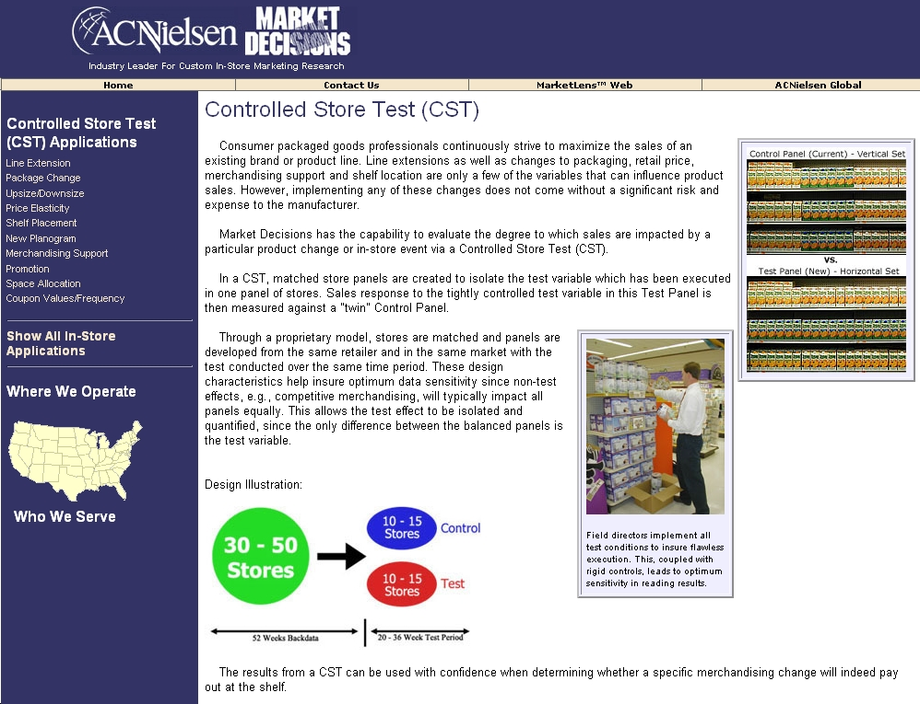
Example: Controlled Store Test

Slide 34
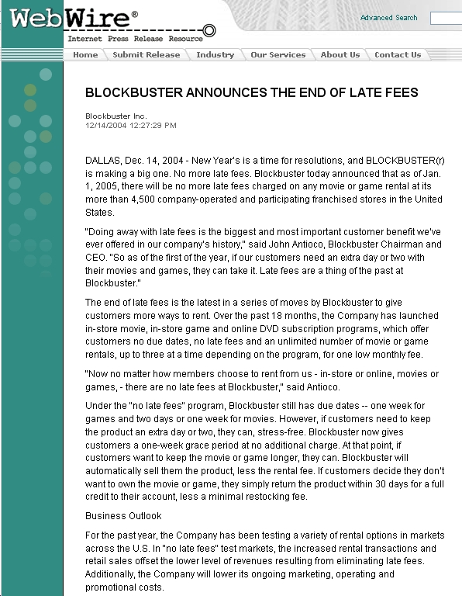

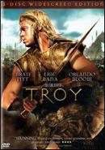


Slide 35
Test Markets
Many uses:
Controlled introduction of a new product
Change of pricing strategy
Change of product design
Choose representative markets
Often as long as one year
Expensive – but highly informative

Slide 36
Lab vs. Field Experiments
Lab Experiment
Artificial setting
Isolated from the routine of ordinary life
Variance of other independent variables kept to a minimum
Respondents aware of being tested – testing effect
e.g. exposure to a new product in a simulated supermarket
Field Experiment
‘Natural’ setting
Within the routine of ordinary life
Difficult to control variance of other independent variables
Respondents not aware of being in a test
e.g. exposure to a new product in a supermarket

Slide 37
Application
Does demand fall when consumers perceive that prices are unfair?
Example: Premium pricing for large sizes in a catalogue
How will you test this?

Slide 38
Design 1
Control catalogues
No difference between the prices of the regular sized clothing and plus sizes
$30, $30
Treatment catalogues
A price premium ($X) for the plus size compared to regular size
$30, $35
Look at the outcome in terms of sales
What could be potential problems?

Slide 39
Design 2
Control catalogues
$30, $30
Treatment catalogues 1
$30, $35
Treatment catalogues 2
$35, $35
Look at the outcome in terms of sales
What extra insight does this design provide?
Reference: Anderson and Simester, Marketing Science, 27(3), 492-500

Slide 40
Trade-Offs
High
External
Validity
Field
Lab
High
Internal
Validity
Real world
Environment
Scientific
Control
(in-market)
(PC - paper/pencil)

Slide 41
Blake et al. – eBay Advertisements
How does paid search affect purchase decisions?
Need correlation or causality?
What did they find?
What did they do?
Data collected and analysis set up
Does paid search ads cause people to purchase more?
Would you recommend increase in search ad expenditure based on this study?
What other factors would affect your recommendation?

Slide 42
Blake et al. – eBay Advertisements
Task: Measure the impact of paid search ads on traffic and attributed sales
Implementation:
Ran a series of controlled experiments for eBay on their paid search campaigns
Finding:
No significant impact of paid search ads on branded and non-branded keywords
Paid search made an impact only on new customers

Slide 43
Blake et al. – eBay Advertisements
Why run experiments in this case?
Location of customers on the CDJ and their use of SEM
Branded keywords vs non-branded keywords
How can these differences be accounted for?

Slide 44
Blake et al. – eBay Advertisements
Step 1: Run an experiment (also known as A/B testing by people who believe the world was created when computers were invented)
You will need a treatment group and a control group
It is important to get the right “control” group. The only difference between the groups must be the “treatment”
How practical is this in reality?
Ebay experiments: Branded Keywords
Treatment Group
Control Group
Paid Search Ads on Google
Paid Search Ads on Microsoft and Yahoo!
Are these two groups the same?

Slide 45
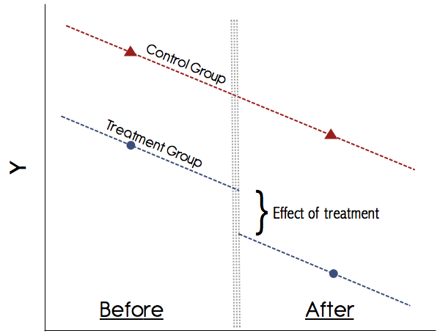
The strategy in this paper - Difference in difference (DID)
Statistical technique used to capture an experimental like setup using observational data
Captures changes in outcome over time between a treatment group and control group
Key requirements
Panel data (requires data before the intervention time period for both treatment and control)
Parallel Trends assumption: Absent the intervention, both treatment and control will be parallel to each other (constant difference)
Other assumptions are also there but the two above are most important.

Slide 46

How do you calculate these effects?
Linear regression once the treatment (T) and treated (X) groups are determined
$$y_{j}=α+β.X+γT+δ.X.T+ε_{j}$$
$δ$ is the treatment effect on the outcome

